Slide 1
8th National Safety Practices Competition
Excellence in Workplace Safety
20th May 2025
Register and upload the Abstract (PDF) before 12th May 2025. Upload your abstract on https://ciibizex.in/safety/

Slide 2
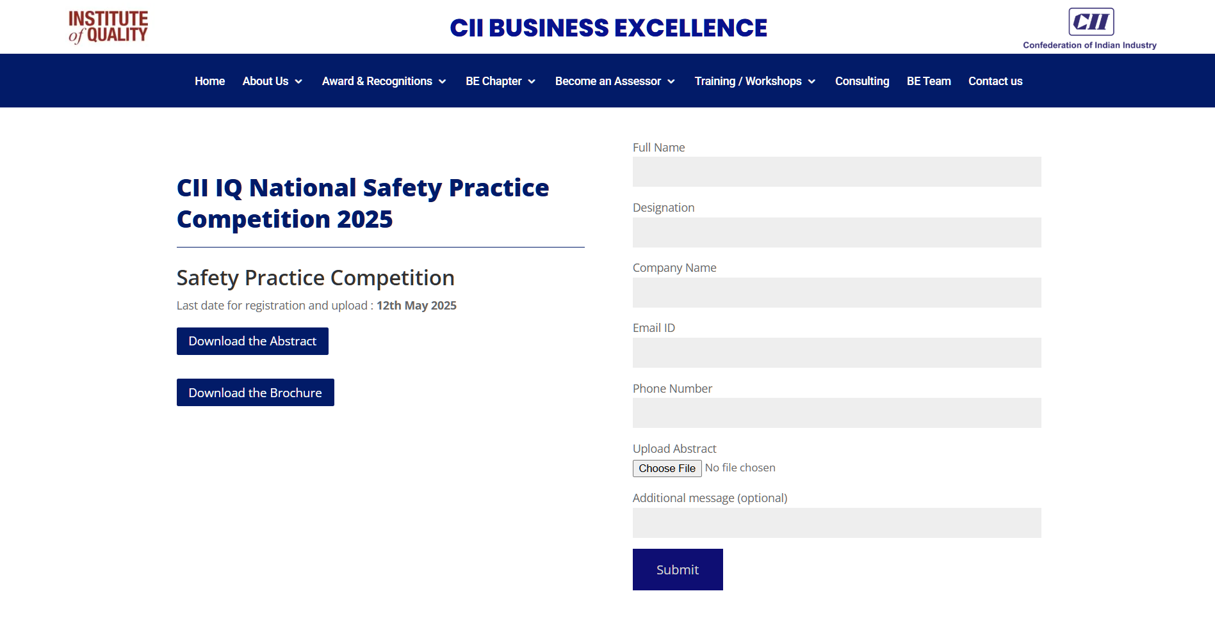

Slide 3
8th CII National Safety Practice Competition 2025 Project Details
Criteria | Description
Project Title
Project Leader
Contact Details of Project Leader | Mob No : Email :
Project Members
Organisation Name and Address
Organisation Name and Address
Primary Sector of your Business | Manufacturing / Service
Sub Sector (Eg: Auto, Process, Pharma, etc under Manufacturing , IT/ITeS, Finance, Academia, Consulting etc under Services)
Project Category | please refer next slide
Note:
Sector is decided based on your primary business and not based on the project focus. Finance, IT, HR etc from a manufacturing organisation,
will fall under Manufacturing sector, and not under services.
For BPO /Outsourced Services/consulting services, the project will fall under Services, even if the final project is done for a manufacturing organisation
Real-estate and Infrastructure, power generation business will be classified under manufacturing for this competition
FMCG, Consumer Goods also will be under manufacturing, but retail chain like the super-markets/hypermarkets, will fall under services,-others.
Power distribution organisations will fall under Services-(public services)
3

Slide 4
8th CII National Safety Practice Competition 2025 Project Details
. Sector: Manufacturing
Streams:
Process Industries like Metal, Chemical, Pharma, Food, Beverages, packaging etc.
Engineering Industries: Engineering/Equipment/Auto/Auto Components/Electronics
Real Estate/Construction /Infrastructure
b. Sector: Services
Streams:
IT&ITeS,
Others - Hospitality, Tourism, Education Healthcare, Financial, etc.
Public Services : Rail, Road, Airport Operations, Police, Electricity Boards, PWD), etc
Note:
Sector is decided based on your primary business and not based on the project focus. Finance, IT, HR etc from a manufacturing organisation,
will fall under Manufacturing sector, and not under services.
For BPO /Outsourced Services/consulting services, the project will fall under Services, even if the final project is done for a manufacturing organisation
Real-estate and Infrastructure, power generation business will be classified under manufacturing for this competition
FMCG, Consumer Goods also will be under manufacturing, but retail chain like the super-markets/hypermarkets, will fall under services,-others.
Power distribution organisations will fall under Services-(public services)
4

Slide 5
Project Abstract
Please provide brief information in 2-4 slides, under each headings. Information to be brief and to the point . You can use text, Picture, Graph, flowchart etc as appropriate
Total slides describing the project should not be more than 4 . No additional information required at this stage, unless it is requested after primary review.
5

Slide 6
8th CII National Safety Practice Competition 2025 Project Details
Project Title :-
5. Plan Vs Actual of the results / Benefits achieved?
2. Brief Description of the Practice &
the primary reason for choosing this
3. Explain about your execution plan with significant milestones
4. Uniqueness
6

Slide 7
8th CII National Safety Practice Competition 2025 Project Details
6. Proposed actions and activity plan
8.Results/Benefits
7. Activity Implementation Status
9. Key learnings
7

